Slide 1

SUPERSTORE MARKETING CAMPAIGN ANALYSIS
Prepared by : Vanshika Srivastava

Slide 2
Project Overview
DATASET
OBJECTIVE
To segment customers, understand purchasing behavior, predict campaign acceptance, identify key drivers such as recency and category spend, etc. And recommend strategies to increase membership uptake.
CHALLENGE
The dataset faces low response rate(14.91%), class imbalance, missing values, fragmented behavior patterns, inconsistent date formats, unreal ages of some customers, and unclear category performance.
The dataset contains 2,240 customers and 22 features including customer demographics, channel preferences, spending behaviour, complaints, response, and purchase recency.

Slide 3




Tools Used
Excel
SQL
Python
Power BI
Data Querying
Data Cleaning, Analysis & Modelling
Data Visualization
Data Source and Validation

Slide 4
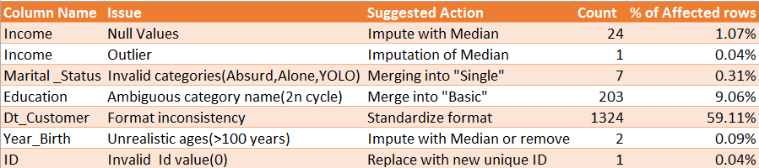
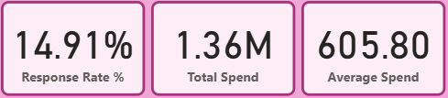
Data Quality & KPIs
Data Quality Log summarizes detected issues and recommended cleaning actions.
These KPIs summarize campaign effectiveness, total customer spending, and average customers value.

Slide 5

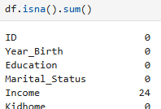

Data Validation
Checking distinct counts for categorical fields in SQL
Checking Min/Max ranges for numerical columns
Checking duplicate rows in Python
Validating missing/Null values across columns
Reviewing the Dataset dimensions

Slide 6
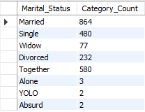
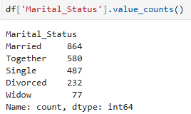
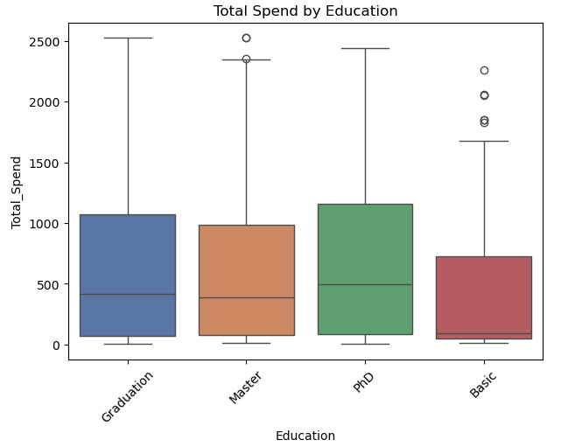
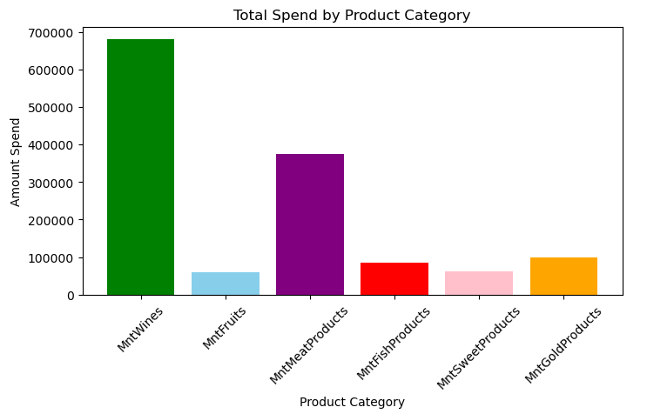
Data Cleaning & EDA
BEFORE
Handled missing values and outlier in Income column.
Standardized categories and date formats.
Created new features such as Tenure, Age, Category Breadth, Total Spend, etc for analysis.
AFTER

Slide 7
Statistical Analysis
T-TEST
(Total Spend)
Purpose: Total Spend with Kids and Without Kids
Result: p- value <0.05, reject null hypothesis
Insight: Customers without kids spend more than customers with children.
T-TEST
(Resp-onse)
Purpose: Acceptance rate with Kids and without Kids
Result: p- value <0.05, reject null hypothesis
Insight: Family status affects campaign acceptance.
A
N
O
V
A
Purpose: Effect of Income Bracket on Total Spend
Result: p- value <0.05, reject null hypothesis
Insight: Spending increases significantly with income.
A
N
O
V
A
Purpose: Effects of Marital Status on Total Spend
Result: p- value >0.05, fail to reject null hypothesis
Insight:Marital Status does not show a significant effect on Total spend.
Chi-
Square
Test
Purpose: Association between Education and Response
Result: p- value <0.05, reject null hypothesis
Insight: Education and Response are associated; acceptance rate is not equal.
Chi-
Square
Test
Purpose: Association between Marital Status and Response
Result: p- value <0.05, reject null hypothesis
Insight: The response rate is different across Marital Status categories.

Slide 8
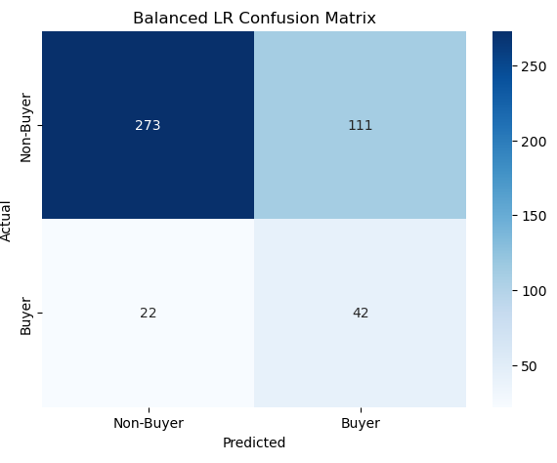
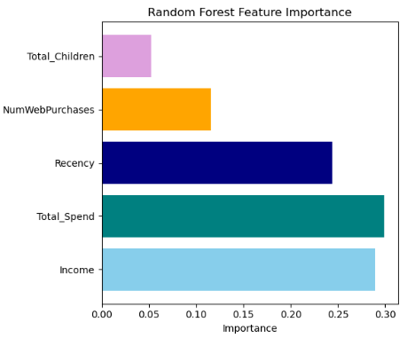
Predictive Modelling
Random Forest
Balanced LR
Logistic Regression
Model | Accuracy | Recall | Buyers
Logistic Regression | 85.71% | 6.25% | 4
Balanced Logistic Regression | 70.31% | 65.62% | 42
Random Forest | 85.94% | 28.12% | 18

Slide 9
Key Business Insights
High Income customers spend the highest and showed better response.
Customers without children spent more (₹1106 vs ₹406) and have a higher acceptance rate of 26.48%.
Customers purchases the highest from Store followed by Web.
Wines generates the largest share of customer spending followed by Meat.
PhD customers showed the highest response rate of 20.7%, while Widow customers showed the highest response rate of 24.7%.

Slide 10
Recommendations
For High-income: VIP rewards & personalized campaigns
For Low-income: Discounts, EMI & flexible payment options
Target high recency customers using reminder emails, WhatsApp & limited time offers
Strengthen Store purchase for trust,
Promote Digital/Web purchases via free delivery & discounts
Provide family offers and bundle discounts to customers with children to improve engagement and increase spending.

Slide 11
Business Impact
Problem: Low buyer identification due to poor recall (6.25%)
Solution: Applied Balanced Logistic Regression model
Impact: Recall improved to 65.62%, increasing buyers from 4 to 42
Problem: Low ROI from untargeted campaigns
Solution: Focused on high-income segments customers (>80k)
Impact: Achieved 39.9% response rate vs 12.2% in low-income segment
Problem: Inactive customers are assumed unresponsive
Solution: Analyzed high recency customers (80+) for response behavior
Impact: Identified 26 inactive customers who still responded, enabling win-back opportunities

